Slide 1
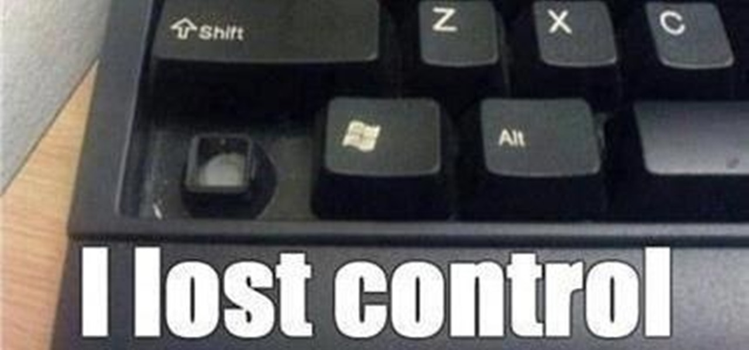
Lesson 5 -Control Flow
A controlling controller controls controls.
Ben Schwarz

Slide 2
Intro
Up until now, all your programs have done the same thing over and over.
This is great and all. But what if you want your program to make a decision and then act upon this?
Well this is where control flow comes into play.
There are many different ways to make decisions. Let’s look at a few.

Slide 3
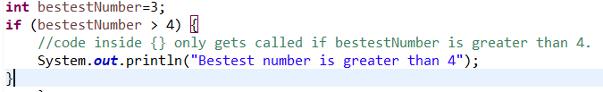
If statements
If statements will only run code if a condition is true
Example:

Slide 4
If statement broken down
This is the condition. If it is true the code in the block (code surrounded by curly brackets) is called.
The condition could be an expression like above or just simply a Boolean such as a variable.

Slide 5
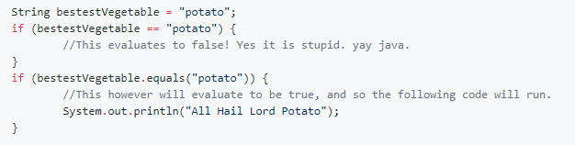
Operator List
Operator | What it does | Example
== | Equal to | (2==2)
!= | Not equal to | (2!=3)
> | Greater than | (3>2)
>= | Greater than or equal to | (3>=2)
< | Less than | (2<3)
<= | Less than or equal to | (-5<=-5)
When comparing Strings, you can’t use == but have to use .equals()

Slide 6
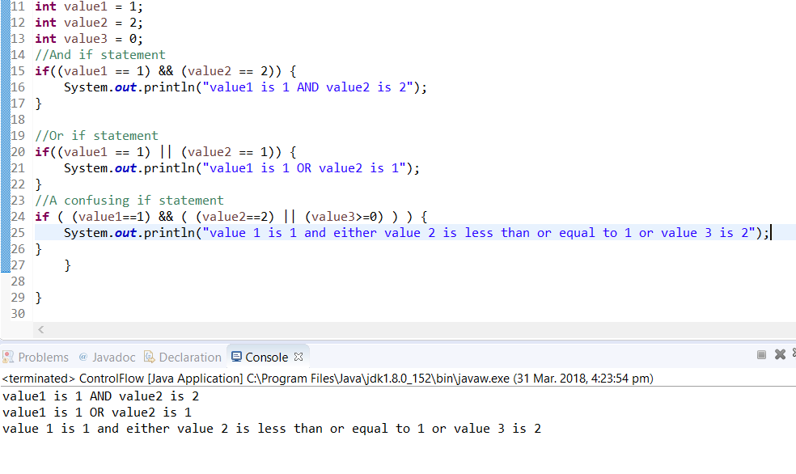
AND/OR operators
Sometimes you want to check for multiple statements being true or if one of multiple statements are true.
&& - and. True if all conditions are true.
|| - or (Shift+Backslash). True if any condition is true.
Note that you can chain statements together and they follow BODMAS.

Slide 7
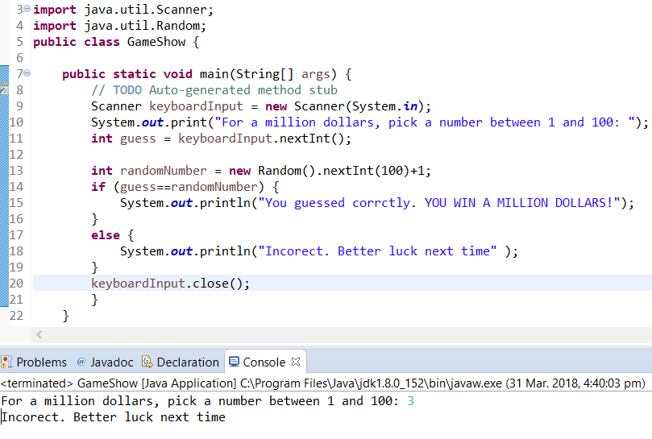
If/Else
Sometimes you want to run code if the if statement is false. Like a fork in the road.
Here we use an else statement. Example:

Slide 8
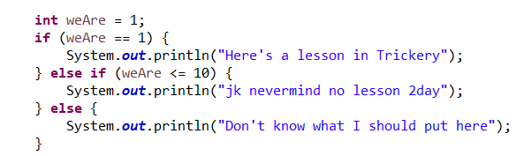
Else if
I can probably show this with an example better than some long explanation. See:
As you can see it would currently trigger at first. BUT if weAre = 8, then it would trigger at the second, else if, option. BUT if it was like 4613, then it would trigger at the last, else, statement

Slide 9
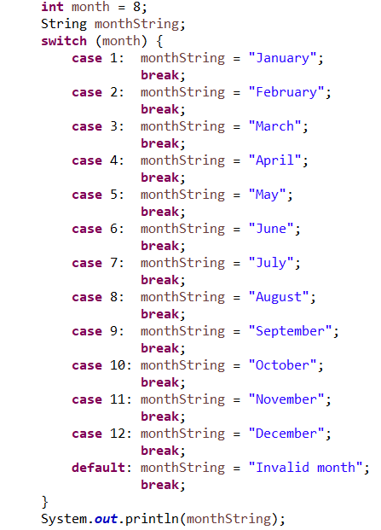
Switch Statements:
Sometimes you want to select from lots of different options. Example:

Slide 10
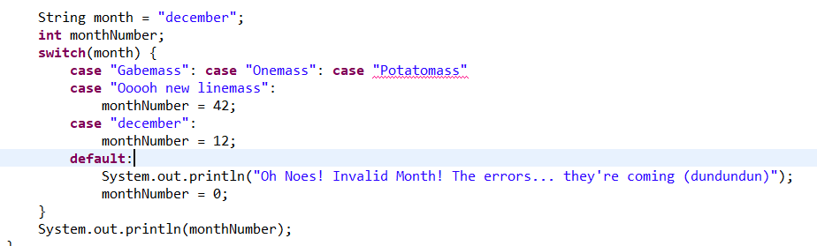
You can also use Strings to switch or Enumerations (which are fancy and for later)
Unfortunately, this always returns 0 and prints out the error message. Why? The "break;" was forgotten! The "break;" is really important, without it the program 'falls through' and start executing the next cases. So the monthNumber get's set to 12... but then it keeps on running, prints out the error message, and sets the number to 0. You need to include "break" to remind Java to stop executing the next cases.
As shown above, you can have multiple cases run the same block. "Gabemass", "Onemass", "Potatomass" and "Ooooh new linemass" would all get a monthNumber of 42.
Everything in a switch statement can be done with ifs. It's just a judgement call as to what's more appropriate, makes sense, looks nice, and fits in line with what you're trying to do.

Slide 11
Activities:
1.Ask someone their favourite colour. Make a judgement as to if they have a chosen a correct favourite colour, and inform them of if they get their decision wrong.
2.Make a calendar program which will output what the current day of the week is from the date - Wikipedia has several methods, see https://en.wikipedia.org/wiki/Determination_of_the_day_of_the_week#A_tabular_method_to_calculate_the_day_of_the_week . Note that a (whole) number % 100 will return the last two digits (10s and 0s). (FYI you can have people enter in the date seperately - i.e. ask the day, month and year.)

